Slide 1
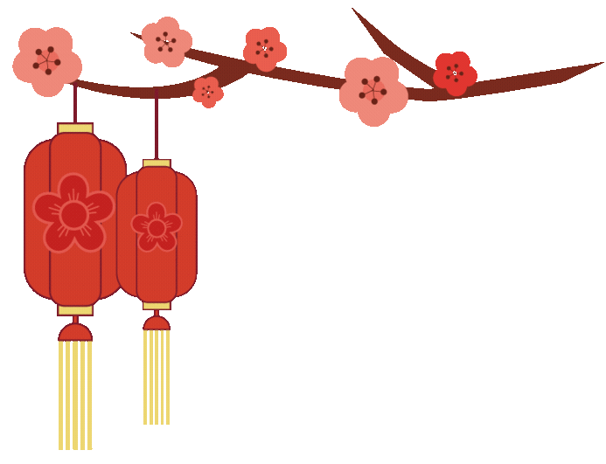
The Story of
the Lantern Festival

Slide 2
Long ago,
a palace maid named Yuanxiao
missed her family and felt very sad.

Slide 3
A wise man, Dongfang Shuo,
came up with a plan.

Slide 4
He told the emperor that
lighting lanterns and setting off fireworks would save the city from a great fire.

Slide 5
On the 15th day of the first lunar month,
the whole city lit up,
and Yuanxiao was allowed to see her family.

Slide 6
The emperor loved the celebration
and made it a tradition.

Slide 7
People also named sweet rice balls "Yuanxiao" after her,
and that’s how the Lantern Festival began!

